Slide 1


Slide 2
ThE task:
Use Topological data analysis on flight traffic data:
How will I get the data?
What does the data look like?
What is Topological data analysis? (TDA)
What can I use TDA for?

Slide 3
How will I get the data?
Opensky Network
Has large crowd sourced database
Official python library to query the database for flights
Another python library to visualize and query flights

Slide 4
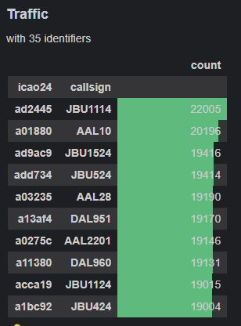
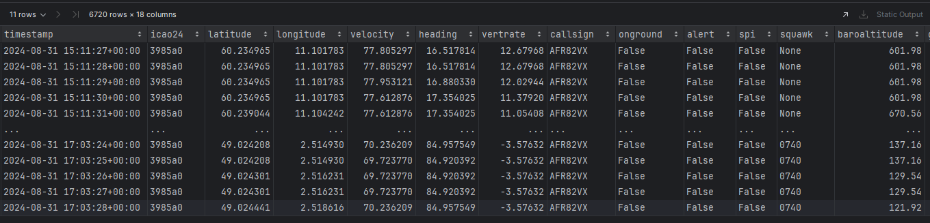
What does the data look like?
2 main objects:
Traffic holds data about many flights
Flight holds data about a single flight
Both are Pandas data-frames at the core.

Slide 5
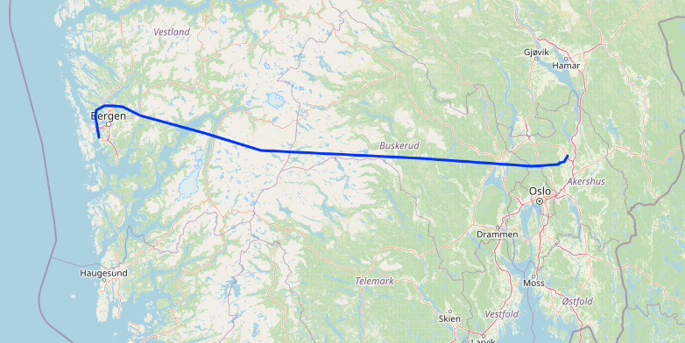
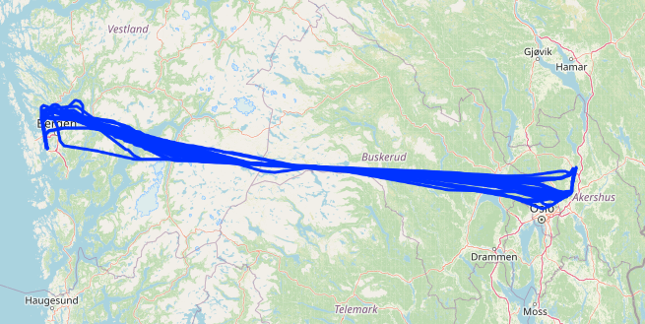
What does the data look like?
A flight from Gardemoen to Flesland the 4th of September
All the flights from Gardermoen to Flesland between the 29th of August to the 5th of September

Slide 6
Potential issues with the data:
The data is crowd sourced by hobbyists
Data is collected by airplane radio sensors
Missing data outside of population centers
Missing data in oceans
Coverage map
Conclusion:
Probably best to focus on flights within Europe and the USA

Slide 7
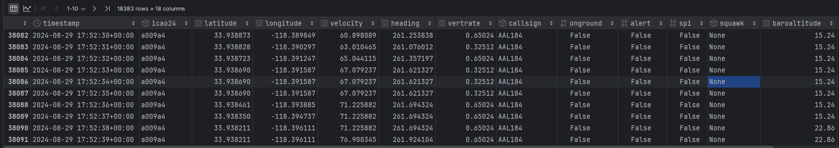
Potential issues with the data:
There is a lot of data
Each flight is has a row for every second.
TDA is not the most efficient
working with millions of rows could be problematic
18000 rows for 1 flight

Slide 8
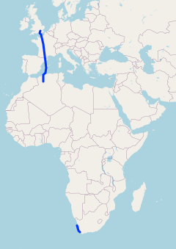
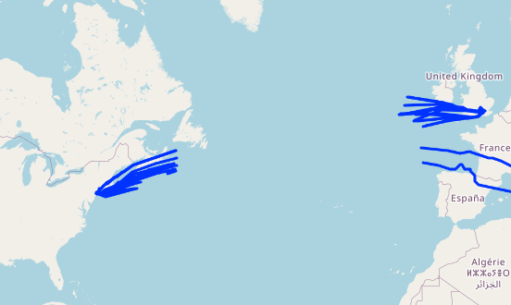
Potential issues with the data:
Missing data over the Atlantic ocean
Missing data over most of Africa

Slide 9
What is Topological data analysis? (TDA)

Slide 10
What can I use TDA for?
Goal of the TDA is a bit uncertain
Potential usages could be:
Could be used to predict whether there has been an emergency
Could be used to predict whether an airport is busy

Slide 11
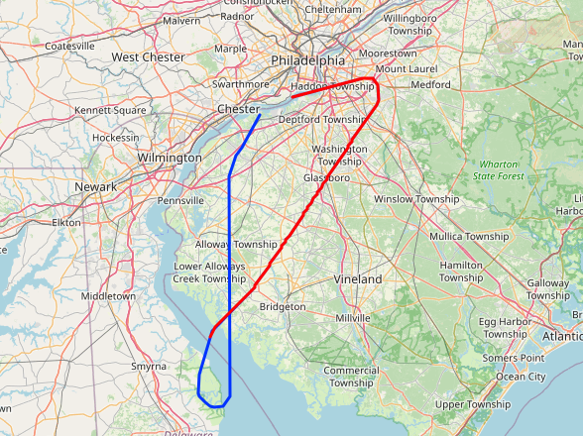
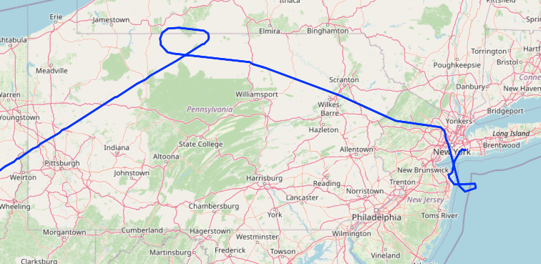
What can I use TDA for?
Could be used to predict whether an airport is busy
Could be used to predict whether there has been an emergency

